Slide 1
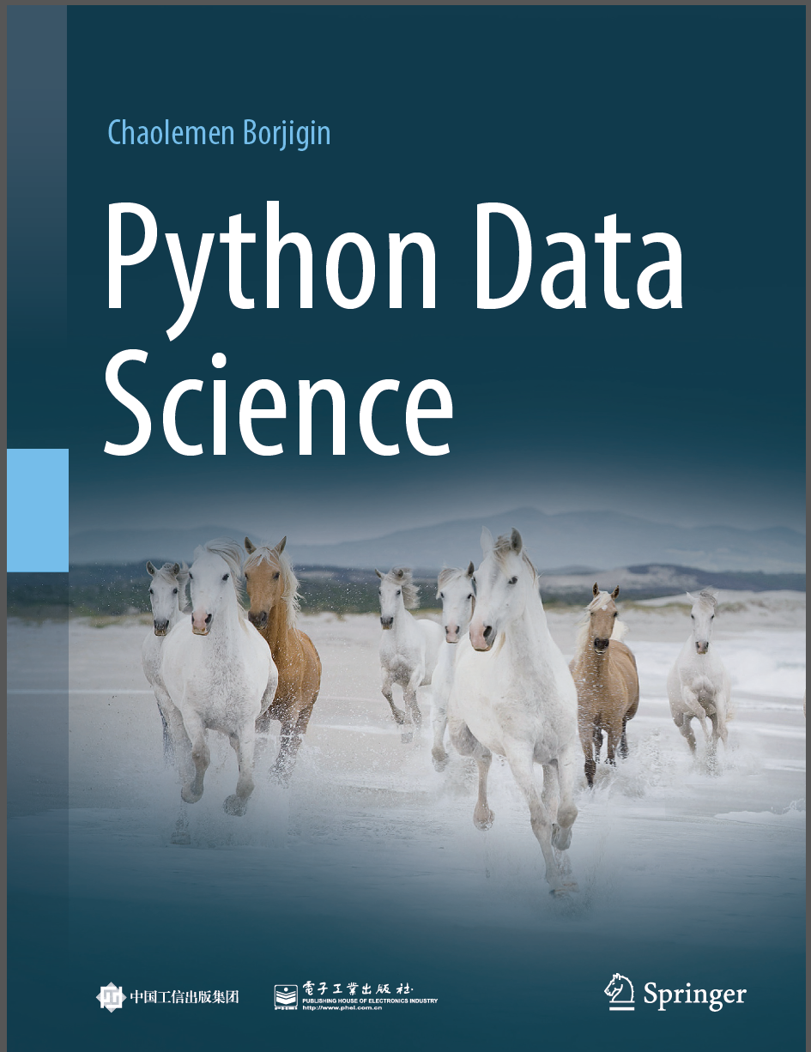
Python Programming —— From Data Analysis to Data Science
Chaolemen Borjigin
Renmin University of China
chaolemen@ruc.edu.cn

Slide 2
4.4 DataFrame
Chaolemen Borjigin
Renmin University of China
chaolemen@ruc.edu.cn

Slide 3
Summary of this chapter
▼Chapter 4 Data processing
► 4.4 DataFrame
4.4.1 Creating DataFrames
4.4.2 Index or columns of DataFrames
4.4.3 Slicing DataFrames
4.4.4 Filtering DataFrames
4.4.5 Arithmetic operating on DataFrames

Slide 4
Summary of this chapter
▼Chapter 4 Data processing
► 4.4 DataFrame
4.4.10 Grouping DataFrames
4.4.8 Importing/Exporting DataFrames
4.4.9 Handling missing values with Pandas
4.4.7 Sorting DataFrames
4.4.6 Descriptive analysis of DataFrames

Slide 5

4.4.1 Creating DataFrames
▼Chapter 4 Data processing
► 4.4 DataFrame
In[2]:
import numpy as np
import pandas as pd
df1=pd.DataFrame(np.arange(10).reshape(2,5))
df1
Out[2]:
In[3]:
df2 = pd.read_csv('bc_data.csv')
df2.shape
(569, 32)
Out[3]:

Slide 6
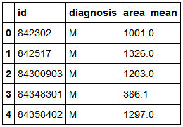
4.4.1 Creating DataFrames
▼Chapter 4 Data processing
► 4.4 DataFrame
In[4]:
df2=df2[["id","diagnosis","area_mean"]]
df2.head()
Out[4]:

Slide 7
4.4.2 Index or columns of DataFrames
▼Chapter 4 Data processing
► 4.4 DataFrame
In[5]:
df2.index
Out[5]:
RangeIndex(start=0, stop=569, step=1)
df2.index.size
In[6]:
Out[6]:
569
In[7]:
df2.columns
Out[7]:
Index(['id', 'diagnosis', 'area_mean'], dtype='object')

Slide 8
4.4.2 Index or columns of DataFrames
▼Chapter 4 Data processing
► 4.4 DataFrame
In[8]:
df2.columns.size
Out[8]:
3
df2.shape
In[9]:
Out[9]:
(569, 3)
In[10]:
print("the number of rows:", df2.shape[0])
print("the number of columns:", df2.shape[1])
Out[10]:
the number of rows: 569
the number of columns:3

Slide 9
4.4.3 Slicing DataFrames
▼Chapter 4 Data processing
► 4.4 DataFrame
In[13]:
df2["id"].head()
Out[13]:
0 842302
1 842517
2 84300903
3 84348301
4 84358402
Name: id, dtype: int64

Slide 10
4.4.3 Slicing DataFrames
▼Chapter 4 Data processing
► 4.4 DataFrame
In[14]:
df2.id.head()
Out[14]:
0 842302
1 842517
2 84300903
3 84348301
4 84358402
Name: id, dtype: int64
df2["id"][2]
In[15]:
Out[15]:
84300903

Slide 11
4.4.3 Slicing DataFrames
▼Chapter 4 Data processing
► 4.4 DataFrame
In[16]:
df2.id[2]
Out[16]:
84300903
df2["id"][[2,4]]
In[17]:
Out[17]:
2 84300903
4 84358402
Name: id, dtype: int64
In[18]:
df2.loc[1,"id"]
Out[18]:
842517

Slide 12


4.4.3 Slicing DataFrames
▼Chapter 4 Data processing
► 4.4 DataFrame
In[19]:
df2.iloc[1,0]
Out[19]:
842517
In[20]:
df2.ix[[1],["id"]]
Out[20]:
In[21]:
df2.ix[[1,5],["id"]]
Out[21]:

Slide 13

4.4.3 Slicing DataFrames
▼Chapter 4 Data processing
► 4.4 DataFrame
In[22]:
df2.ix[1:5,["id"]]
Out[22]:

Slide 14
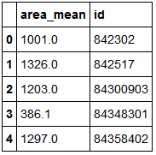
4.4.3 Slicing DataFrames
▼Chapter 4 Data processing
► 4.4 DataFrame
In[23]:
df2[["area_mean","id"]].head()
Out[23]:

Slide 15
4.4.3 Slicing DataFrames
▼Chapter 4 Data processing
► 4.4 DataFrame
In[24]:
df2.index
Out[24]:
RangeIndex(start=0, stop=569, step=1)
In[25]:
df2.columns
Out[25]:
Index(['id', 'diagnosis', 'area_mean'], dtype='object')
In[26]:
df2["id"].head()
Out[26]:
0 842302
1 842517
2 84300903
3 84348301
4 84358402
Name: id, dtype: int64

Slide 16
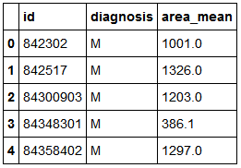
4.4.3 Slicing DataFrames
▼Chapter 4 Data processing
► 4.4 DataFrame
In[27]:
df2.reindex(index=["1","2","3"],columns=["1","2","3"])
df2.head()
Out[27]:

Slide 17
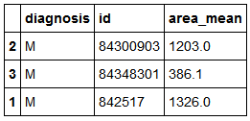
4.4.3 Slicing DataFrames
▼Chapter 4 Data processing
► 4.4 DataFrame
In[28]:
df2.reindex(index=[2,3,1], columns=["diagnosis","id","area_mean"])
Out[28]:

Slide 18
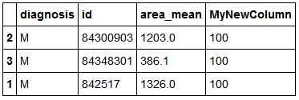
4.4.3 Slicing DataFrames
▼Chapter 4 Data processing
► 4.4 DataFrame
In[29]:
df3=df2.reindex(index=[2,3,1], columns=["diagnosis","id","area_mean","MyNewColumn"],fill_value=100)
df3
Out[29]:

Slide 19
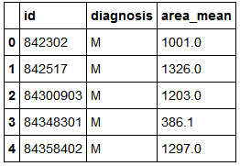
4.4.4 Filtering DataFrames
▼Chapter 4 Data processing
► 4.4 DataFrame
In[30]:
import pandas as pd
df2 = pd.read_csv('bc_data.csv')
df2=df2[["id","diagnosis","area_mean"]]
df2.head()
Out[30]:

Slide 20
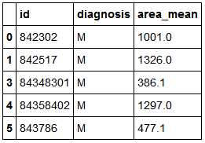
4.4.4 Filtering DataFrames
▼Chapter 4 Data processing
► 4.4 DataFrame
In[31]:
df2.drop([2]).head()
Out[31]:

Slide 21
4.4.4 Filtering DataFrames
▼Chapter 4 Data processing
► 4.4 DataFrame
In[32]:
df2.head()
Out[32]:

Slide 22
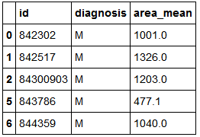
4.4.4 Filtering DataFrames
▼Chapter 4 Data processing
► 4.4 DataFrame
In[33]:
import pandas as pd
df2 = pd.read_csv('bc_data.csv')
df2=df2[["id","diagnosis","area_mean"]]
df2.drop([3,4], axis=0, inplace=True)
df2.head()
Out[33]:

Slide 23
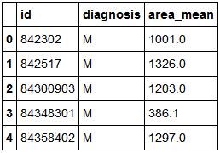
4.4.4 Filtering DataFrames
▼Chapter 4 Data processing
► 4.4 DataFrame
In[34]:
import pandas as pd
df2 = pd.read_csv('bc_data.csv')
df2=df2[["id","diagnosis","area_mean"]]
df2.drop([3,4], axis=0, inplace=False)
df2.head()
Out[34]:

Slide 24
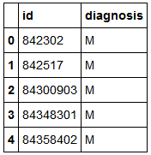
4.4.4 Filtering DataFrames
▼Chapter 4 Data processing
► 4.4 DataFrame
In[35]:
import pandas as pd
df2 = pd.read_csv('bc_data.csv')
df2=df2[["id","diagnosis","area_mean"]]
del df2["area_mean"]
df2.head()
Out[35]:

Slide 25
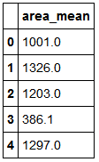
4.4.4 Filtering DataFrames
▼Chapter 4 Data processing
► 4.4 DataFrame
In[36]:
import pandas as pd
df2 = pd.read_csv('bc_data.csv')
df2=df2[["id","diagnosis","area_mean"]]
df2.drop(["id","diagnosis"], axis=1, inplace=True)
df2.head()
Out[36]:

Slide 26
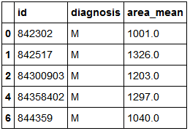
4.4.4 Filtering DataFrames
▼Chapter 4 Data processing
► 4.4 DataFrame
In[37]:
import pandas as pd
df2 =pd.read_csv('bc_data.csv')
df2=df2[["id","diagnosis","area_mean"]]
df2[df2.area_mean> 1000].head()
Out[37]:

Slide 27
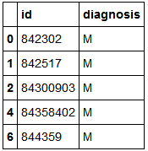
4.4.4 Filtering DataFrames
▼Chapter 4 Data processing
► 4.4 DataFrame
df2[df2.area_mean> 1000][["id","diagnosis"]].head()
In[38]:
Out[38]:

Slide 28


4.4.5 Arithmetic operating on DataFrames
▼Chapter 4 Data processing
► 4.4 DataFrame
df4=pd.DataFrame(np.arange(6).reshape(2,3))
df4
In[39]:
Out[39]:
df5=pd.DataFrame(np.arange(10).reshape(2,5))
df5
In[40]:
Out[40]:

Slide 29


4.4.5 Arithmetic operating on DataFrames
▼Chapter 4 Data processing
► 4.4 DataFrame
In[41]:
df4+df5
Out[41]:
df6=df4.add(df5,fill_value=10)
df6
In[42]:
Out[42]:

Slide 30

4.4.5 Arithmetic operating on DataFrames
▼Chapter 4 Data processing
► 4.4 DataFrame
In[43]:
s1=pd.Series(np.arange(3))
s1
Out[43]:
0 0
1 1
2 2
dtype: int32
In[44]:
df6-s1
Out[44]:

Slide 31

4.4.5 Arithmetic operating on DataFrames
▼Chapter 4 Data processing
► 4.4 DataFrame
In[45]:
df5=pd.DataFrame(np.arange(10).reshape(2,5))
s1=pd.Series(np.arange(3))
df5-s1
Out[45]:

Slide 32

4.4.5 Arithmetic operating on DataFrames
▼Chapter 4 Data processing
► 4.4 DataFrame
In[46]:
df5=pd.DataFrame(np.arange(10).reshape(2,5))
s1=pd.Series(np.arange(3))
df5.sub(s1,axis=1)
Out[46]:

Slide 33
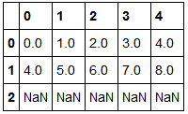
4.4.5 Arithmetic operating on DataFrames
▼Chapter 4 Data processing
► 4.4 DataFrame
In[47]:
df5=pd.DataFrame(np.arange(10).reshape(2,5))
s1=pd.Series(np.arange(3))
df5.sub(s1,axis=0)
Out[47]:

Slide 34
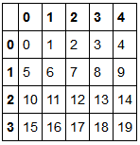
4.4.5 Arithmetic operating on DataFrames
▼Chapter 4 Data processing
► 4.4 DataFrame
In[48]:
df7=pd.DataFrame(np.arange(20).reshape(4,5))
df7
Out[48]:

Slide 35
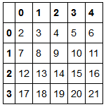
4.4.5 Arithmetic operating on DataFrames
▼Chapter 4 Data processing
► 4.4 DataFrame
In[49]:
df7+2
Out[49]:

Slide 36
4.4.5 Arithmetic operating on DataFrames
▼Chapter 4 Data processing
► 4.4 DataFrame
In[50]:
print(df7)
print("df7.cumsum=",df7.cumsum())
0 1 2 3 4
0 0 1 2 3 4
1 5 6 7 8 9
2 10 11 12 13 14
3 15 16 17 18 19
df7.cumsum= 0 1 2 3 4
0 0 1 2 3 4
1 5 7 9 11 13
2 15 18 21 24 27
3 30 34 38 42 46

Slide 37
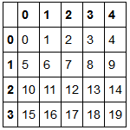
4.4.5 Arithmetic operating on DataFrames
▼Chapter 4 Data processing
► 4.4 DataFrame
In[51]:
df7
Out[51]:

Slide 38
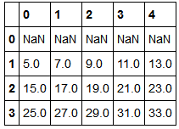
4.4.5 Arithmetic operating on DataFrames
▼Chapter 4 Data processing
► 4.4 DataFrame
In[52]:
df7.rolling(2).sum()
Out[52]:

Slide 39
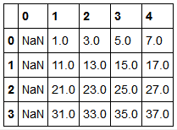
4.4.5 Arithmetic operating on DataFrames
▼Chapter 4 Data processing
► 4.4 DataFrame
In[53]:
df7.rolling(2,axis=1).sum()
Out[53]:

Slide 40
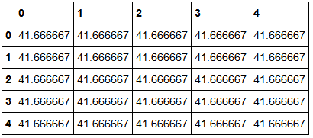
4.4.5 Arithmetic operating on DataFrames
▼Chapter 4 Data processing
► 4.4 DataFrame
In[54]:
df7.cov()
Out[54]:

Slide 41
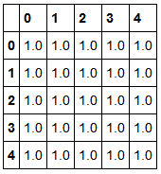
4.4.5 Arithmetic operating on DataFrames
▼Chapter 4 Data processing
► 4.4 DataFrame
In[55]:
df7.corr()
Out[55]:

Slide 42
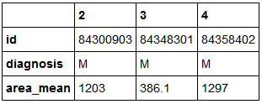
4.4.5 Arithmetic operating on DataFrames
▼Chapter 4 Data processing
► 4.4 DataFrame
In[56]:
import pandas as pd
df2 = pd.read_csv('bc_data.csv')
df2=df2[["id","diagnosis","area_mean"]][2:5]
df2.T
Out[56]:

Slide 43

4.4.5 Arithmetic operating on DataFrames
▼Chapter 4 Data processing
► 4.4 DataFrame
In[57]:
print(df6)
0 1 2 3 4
0 0 2 4 13.0 14.0
1 8 10 12 18.0 19.0
Out[57]:
df6>5
In[58]:
Out[58]:

Slide 44

4.4.5 Arithmetic operating on DataFrames
▼Chapter 4 Data processing
► 4.4 DataFrame
In[59]:
print(s1)
Out[59]:
0 0
1 1
2 2
dtype: int32
In[60]:
df6>s1
Out[60]:

Slide 45

4.4.5 Arithmetic operating on DataFrames
▼Chapter 4 Data processing
► 4.4 DataFrame
In[61]:
df6>(2,18)
Out[61]:

Slide 46
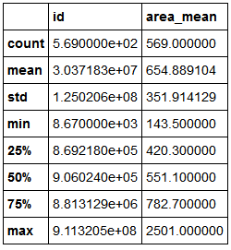
4.4.6 Descriptive analysis of DataFrames
▼Chapter 4 Data processing
► 4.4 DataFrame
In[62]:
import numpy as np
import pandas as pd
df2 = pd.read_csv('bc_data.csv')
df2=df2[["id","diagnosis","area_mean"]]
df2.describe()
Out[62]:

Slide 47
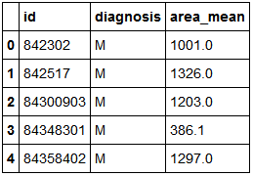
4.4.6 Descriptive analysis of DataFrames
▼Chapter 4 Data processing
► 4.4 DataFrame
In[63]:
dt = df2[df2.diagnosis=='M']
dt.head()
In[64]:
Out[64]:

Slide 48
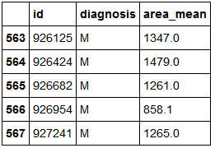
4.4.6 Descriptive analysis of DataFrames
▼Chapter 4 Data processing
► 4.4 DataFrame
In[65]:
dt.tail()
Out[65]:

Slide 49
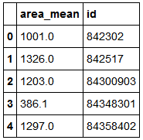
4.4.6 Descriptive analysis of DataFrames
▼Chapter 4 Data processing
► 4.4 DataFrame
In[66]:
df2[df2.diagnosis=='M'].count()
Out[66]:
id 212
diagnosis 212
area_mean 212
dtype: int64
In[67]:
df2[["area_mean","id"]].head()
Out[67]:

Slide 50
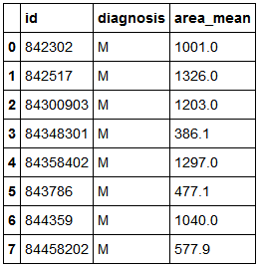
4.4.7 Sorting DataFrames
▼Chapter 4 Data processing
► 4.4 DataFrame
In[68]:
df2.head(8)
Out[68]:

Slide 51
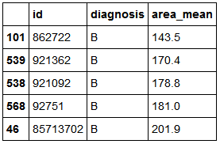
4.4.7 Sorting DataFrames
▼Chapter 4 Data processing
► 4.4 DataFrame
In[69]:
df2.sort_values(by="area_mean",axis=0,ascending=True).head()
Out[69]:

Slide 52
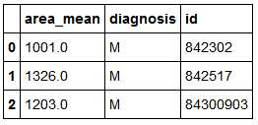
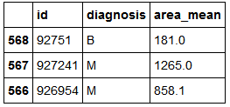
4.4.7 Sorting DataFrames
▼Chapter 4 Data processing
► 4.4 DataFrame
In[70]:
df2.sort_index(axis=1).head(3)
Out[70]:
In[71]:
df2.sort_index(axis=0,ascending=False).head(3)
Out[71]:

Slide 53
4.4.8 Importing/Exporting DataFrames
▼Chapter 4 Data processing
► 4.4 DataFrame
In[72]:
import os
print(os.getcwd())
C:\Users\soloman\clm
df2.head(3).to_csv("df2.csv")
In[73]:
In[74]:
import pandas as pd
df3 = pd.read_csv('df2.csv')

Slide 54
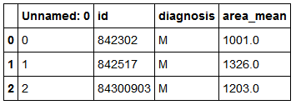
4.4.8 Importing/Exporting DataFrames
▼Chapter 4 Data processing
► 4.4 DataFrame
In[75]:
df3
Out[75]:
In[76]:
df3 = pd.read_csv('df2.csv')

Slide 55
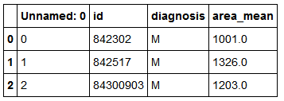
4.4.8 Importing/Exporting DataFrames
▼Chapter 4 Data processing
► 4.4 DataFrame
In[77]:
df3
Out[77]:
df2.head(3).to_excel("df3.xls")
In[78]:

Slide 56
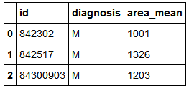
4.4.8 Importing/Exporting DataFrames
▼Chapter 4 Data processing
► 4.4 DataFrame
In[79]:
df3 = pd.read_excel("df3.xls")
df3
Out[79]:

Slide 57
4.4.9 Handling missing values with Pandas
▼Chapter 4 Data processing
► 4.4 DataFrame
In[80]:
df3.empty
Out[80]:
False
np.nan-np.nan +1
In[81]:
Out[81]:
nan
In[82]:
np.nan-np.nan
Out[82]:
nan

Slide 58
4.4.9 Handling missing values with Pandas
▼Chapter 4 Data processing
► 4.4 DataFrame
In[83]:
None+1
---------------------------------------------------------------------------
TypeError Traceback (most recent call last)
<ipython-input-83-6e170940e108> in <module>()
----> 1 None+1
TypeError: unsupported operand type(s) for +: 'NoneType' and 'int'

Slide 59

4.4.9 Handling missing values with Pandas
▼Chapter 4 Data processing
► 4.4 DataFrame
In[84]:
import pandas as pd
import numpy as np
A=pd.DataFrame(np.array([10,10,20,20]).reshape(2,2),columns=list("ab"),index=list("SW"))
A
Out[84]:
In[85]:
list("ab")
Out[85]:
['a', 'b']

Slide 60

4.4.9 Handling missing values with Pandas
▼Chapter 4 Data processing
► 4.4 DataFrame
In[86]:
B=pd.DataFrame(np.array([1,1,1,2,2,2,3,3,3]).reshape(3,3), columns=list("abc"),index=list("SWT"))
B
Out[86]:

Slide 61
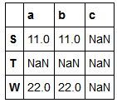
4.4.9 Handling missing values with Pandas
▼Chapter 4 Data processing
► 4.4 DataFrame
In[87]:
C=A+B
C
Out[87]:

Slide 62
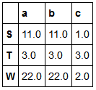
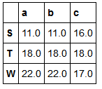
4.4.9 Handling missing values with Pandas
▼Chapter 4 Data processing
► 4.4 DataFrame
In[88]:
A.add(B,fill_value=0)
Out[88]:
In[89]:
A.add(B,fill_value=A.stack().mean())
Out[89]:

Slide 63
4.4.9 Handling missing values with Pandas
▼Chapter 4 Data processing
► 4.4 DataFrame
In[90]:
A.mean()
Out[90]:
a 15.0
b 15.0
dtype: float64
In[91]:
A.stack()
Out[91]:
S a 10
b 10
W a 20
b 20
dtype: int32

Slide 64
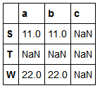
4.4.9 Handling missing values with Pandas
▼Chapter 4 Data processing
► 4.4 DataFrame
In[92]:
A.stack().mean()
Out[92]:
15.0
C
In[93]:
Out[93]:

Slide 65
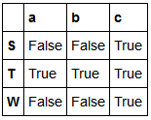
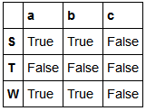
4.4.9 Handling missing values with Pandas
▼Chapter 4 Data processing
► 4.4 DataFrame
In[94]:
C.isnull()
Out[94]:
In[95]:
C.notnull()
Out[95]:

Slide 66

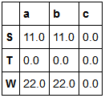
4.4.9 Handling missing values with Pandas
▼Chapter 4 Data processing
► 4.4 DataFrame
In[96]:
C.dropna(axis='index')
Out[96]:
In[97]:
C.fillna(0)
Out[97]:

Slide 67
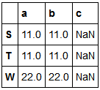
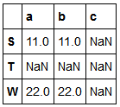
4.4.9 Handling missing values with Pandas
▼Chapter 4 Data processing
► 4.4 DataFrame
In[98]:
C.fillna(method="ffill")
Out[98]:
In[99]:
C.fillna(method="bfill",axis=1)
Out[99]:

Slide 68
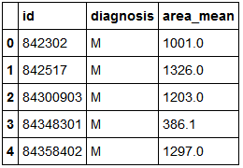
4.4.10 Grouping DataFrames
▼Chapter 4 Data processing
► 4.4 DataFrame
In[100]:
import pandas as pd
df2 = pd.read_csv('bc_data.csv')
df2=df2[["id","diagnosis","area_mean"]]
df2.head()
Out[100]:

Slide 69
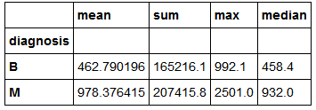
4.4.10 Grouping DataFrames
▼Chapter 4 Data processing
► 4.4 DataFrame
In[101]:
df2.groupby("diagnosis")["area_mean"].mean()
Out[101]:
diagnosis
B 462.790196
M 978.376415
Name: area_mean, dtype: float64
In[102]:
df2.groupby("diagnosis")["area_mean"].aggregate(["mean","sum","max",np.median])
Out[102]:

Slide 70
4.4.10 Grouping DataFrames
▼Chapter 4 Data processing
► 4.4 DataFrame
In[103]:
df2.groupby("diagnosis")["area_mean"].aggregate(["mean","sum"]).unstack()
Out[103]:
diagnosis
mean B 462.790196
M 978.376415
sum B 165216.100000
M 207415.800000
dtype: float64

Slide 71
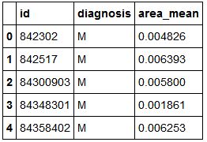
4.4.10 Grouping DataFrames
▼Chapter 4 Data processing
► 4.4 DataFrame
In[104]:
def myfunc(x):
x["area_mean"]/=x["area_mean"].sum()
return x
df2.groupby("diagnosis").apply(myfunc).head()
Out[104]:

Slide 72


